Slide 1
Introduction to AI Agents
Prepared by Ahnaf Hossain Rafi

Slide 2
Analogy: The Chef in a Kitchen
Think of an AI agent as a skilled chef in a busy kitchen. Just like a chef transforms simple ingredients into a delicious meal, an AI agent takes your goals and figures out how to accomplish them step by step.
It's not just following orders—it's thinking, planning, and adapting to get the job done right.

Slide 3
The Goal: A Pizza from a Recipe
The chef starts with a recipe of a pizza to make, which is like the task or command given to an AI Agent. It's a list of what to do, but the chef has to figure out how to make it happen step by step.

Slide 4
Understanding and Planning
The chef reads the recipe and thinks about it: What ingredients do I need? In what order should I chop, mix, and bake? It makes a quick plan, like "First gather tools, then prep veggies, then assemble and cook."
This is the reasoning and planning part for an AI Agent. The agent "thinks" about the goal and breaks it down into a smart plan using its knowledge.

Slide 5
Action and Interaction: Using Kitchen Tools
Now the chef gets to work. It doesn't do everything alone—it use tools like a knife to chop, an oven to bake, or even ask a helper to grab something. The chef directs everything to make the pizza come together.
This shows how an AI Agent acts in its world. It uses "tools" (like searching the internet or writing code) to handle parts of the job, just like the chef uses kitchen gadgets.

Slide 6
Observation and Adaptation: Checking the Taste
While cooking, the chef watches and tastes. Is the dough too sticky? Add more flour. Is it burning? Turn down the heat. It fixes things on the spot to keep everything on track.
This is the observation and adaptation loop for an AI Agent. After acting, it checks the results and changes the plan if needed, like trying a new step to fix a problem.

Slide 7
Achieving the Objective: The Pizza
By planning, using tools, and adjusting as they go, the chef ends up with a perfect pizza that's hot and tasty. It's way better than just throwing ingredients together without thought.
In the same way, an AI Agent combines thinking, acting, and learning from results to handle tricky tasks that a basic AI couldn't do alone. That's what makes it smart and helpful.

Slide 8
AI Agents
An Agent is a system that leverages an AI model to interact with its environment in order to achieve a user-defined objective. It combines reasoning, planning, and the execution of actions (often via external tools) to fulfill tasks.

Slide 9
AI Agents
2 main parts:
The Brain (AI Model): The AI model handles reasoning and planning. It decides which Actions to take based on the situation.
The Body (Capabilities and Tools): This part represents everything the Agent is equipped to do. The scope of possible actions depends on what the agent has been equipped with. For example, because humans lack wings, they can’t perform the “fly” Action, but they can execute Actions like “walk”, “run” ,“jump”, “grab”, and so on.

Slide 10
Level of Agency
Level | Description | What that’s called | Example pattern
1 | Agent output has no impact on program flow | Simple processor | process_llm_output(llm_response)
2 | Agent output determines basic control flow | Router | if llm_decision(): path_a() else: path_b()
3 | Agent output determines function execution | Tool caller | run_function(llm_chosen_tool, llm_chosen_args)
4 | Agent output controls iteration and program continuation | Multi-step Agent | while llm_should_continue(): execute_next_step()
5 | One agentic workflow can start another agentic workflow | Multi-Agent | if llm_trigger(): execute_agent()

Slide 11

Quiz

Slide 12
Types of AI Agents
Simple reflex agents
Model-based reflex agents
Goal-based agents
Utility-based agents
Learning agents

Slide 13
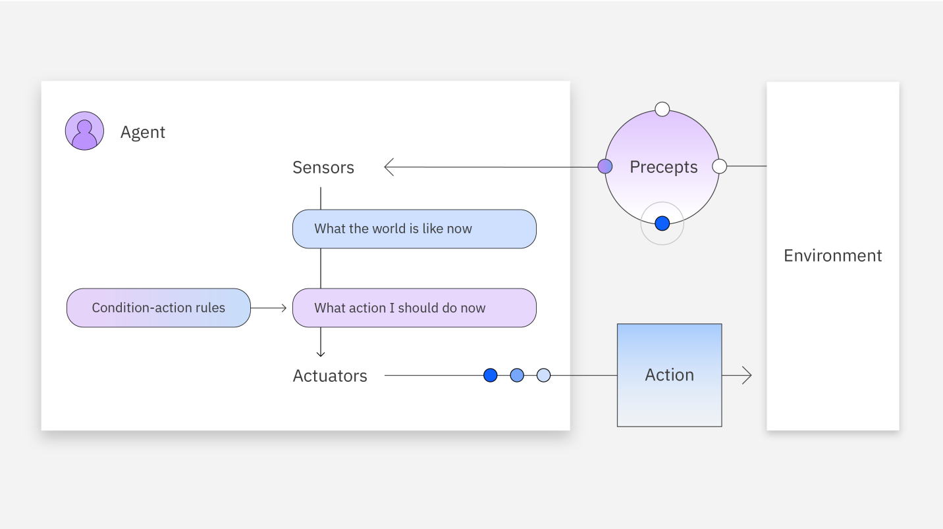
Simple Reflex Agents
Acts directly on environmental inputs using condition–action rules.
Senses the environment and responds with fixed, predefined rules, without using memory or future planning.
Work well in structured, predictable environments with clearly defined rules.
Can’t learn, adapt, or avoid repeating mistakes since they ignore past experiences and future consequences.

Slide 14
Simple Reflex Agents
A cleaning robot vacuums whenever its dirt sensor detects dust.
If dirt detected → start vacuuming. If no dirt → stop.
Doesn’t remember where it already cleaned; it might keep cleaning the same spot.

Slide 15
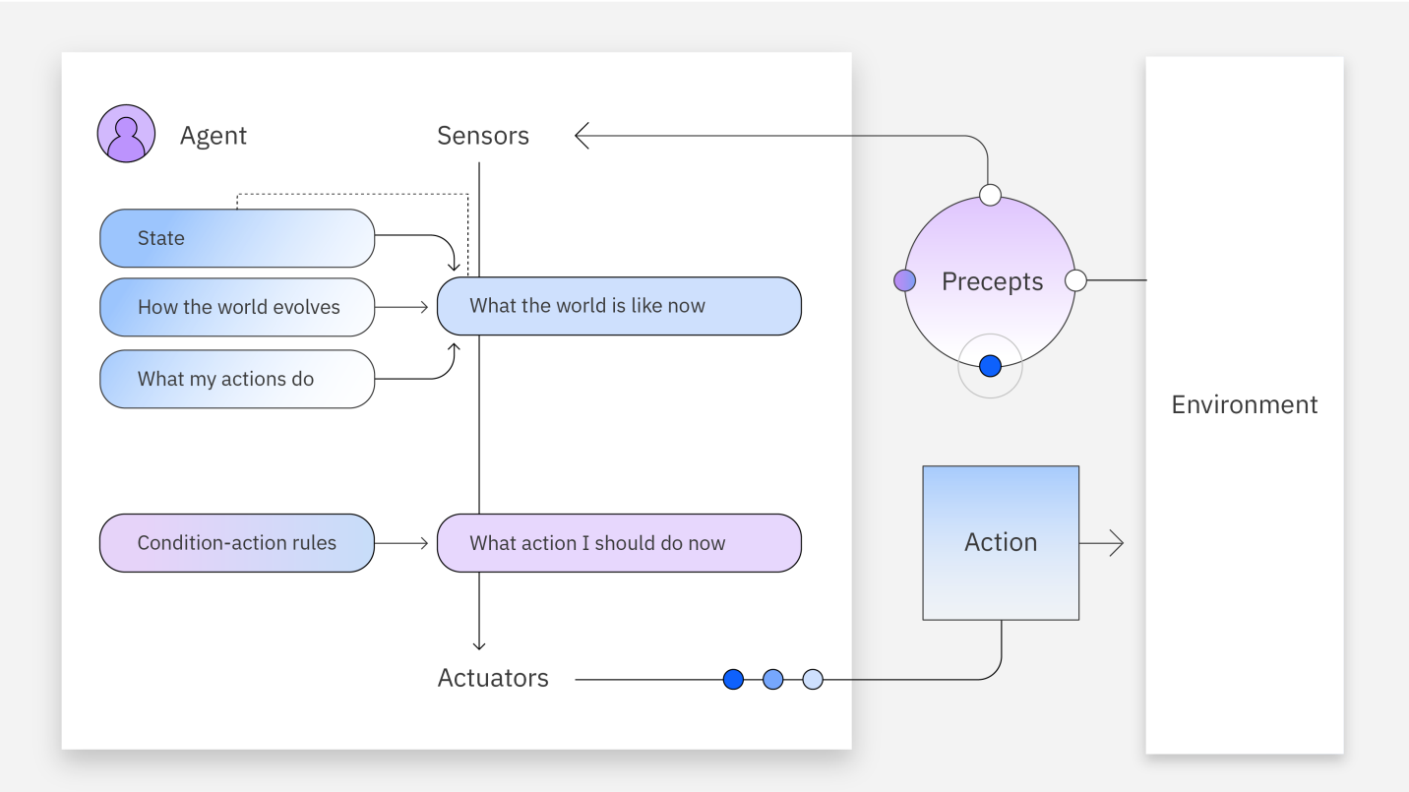
Model-based Reflex Agents
Builds on simple reflex agents by using an internal model of the world alongside condition–action rules.
Tracks the current state of the environment and considers past interactions to make more informed decisions.
Work well in partially observable environments, as they can recall context and adapt better than simple reflex agents.
Lack advanced reasoning and learning abilities for highly dynamic or complex problems.

Slide 16
Model-based Reflex Agents
The robot keeps an internal map of where it has already cleaned.
If sensor detects dirt AND the map shows this spot hasn’t been cleaned → vacuum, else move on.
Remembers past states, avoids redundant cleaning.

Slide 17
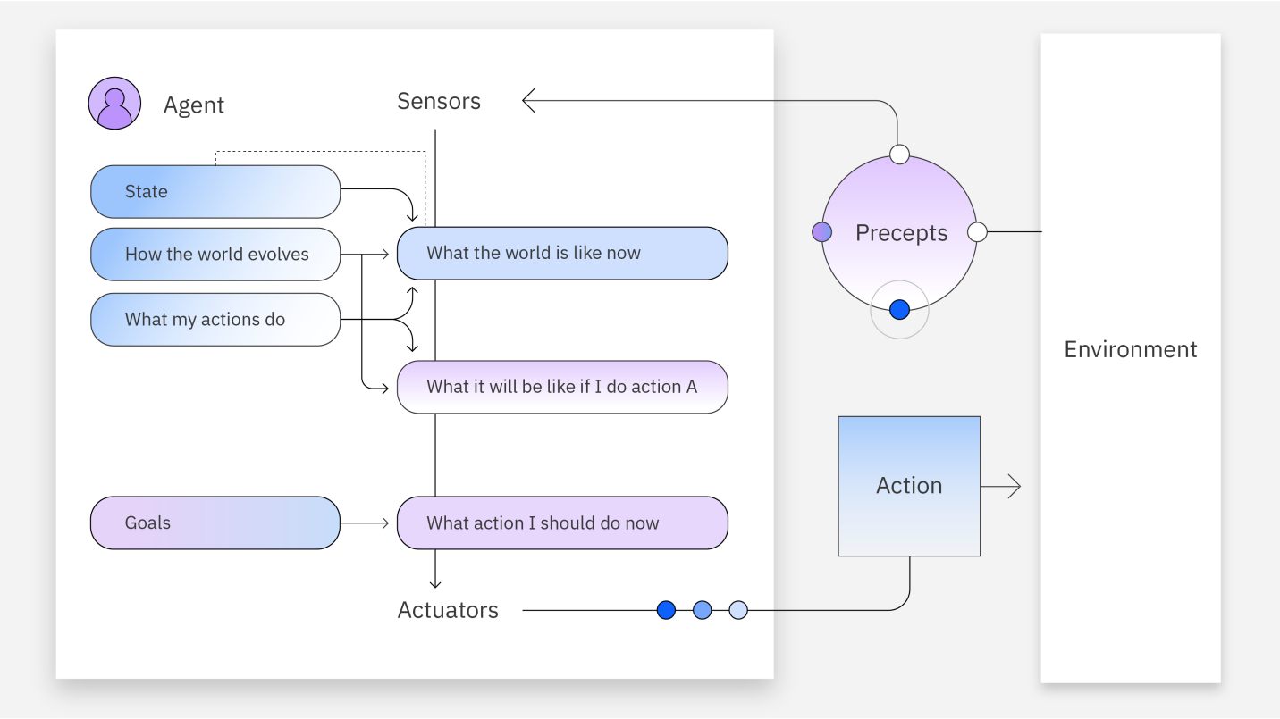
Goal-based Agents
Improves on simple reflex agents by incorporating goal-oriented decision-making.
Sets specific goals and uses planning and reasoning to choose actions that move it closer to achieving them.
Evaluates different possible actions and select the one most likely to help them reach that goal.
Rely on preprogrammed strategies, limiting adaptability in complex scenarios..

Slide 18
Goal-based Agents
The robot’s goal is “make the entire room clean.”
It plans a route to cover all areas of the room efficiently, avoiding unnecessary overlap.
Doesn’t just react; it reasons about future states to achieve the goal faster.

Slide 19
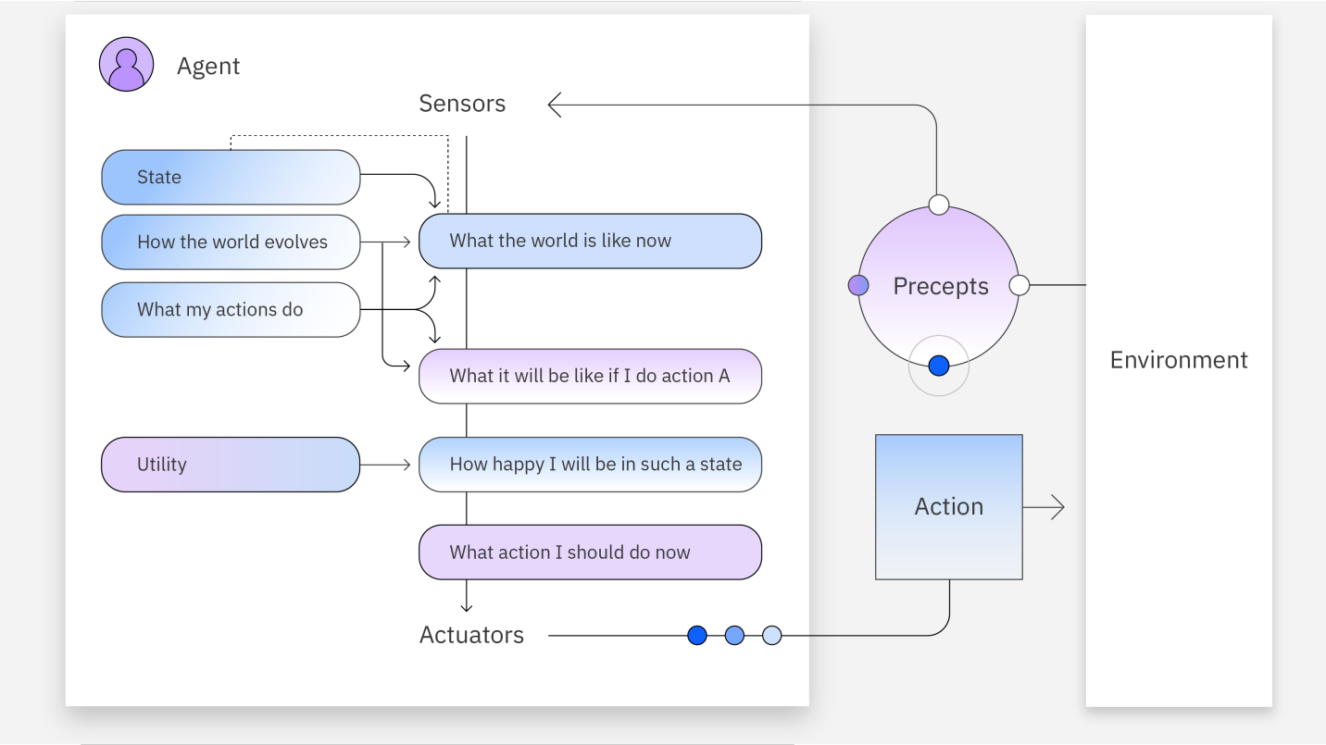
Utility-based Agents
Extends goal-based agents by using a utility function to evaluate and choose the most beneficial action.
Assigns utility values to possible outcomes, balancing multiple goals and tradeoffs to maximize overall benefit.
Effective in dynamic, complex environments where multiple competing objectives must be considered.
Designing accurate utility functions is difficult, as it requires weighing many factors and predicting their impacts.

Slide 20
Utility-based Agents
The robot considers multiple factors: cleanliness level, battery life, and noise.
It chooses actions that maximize overall utility — e.g., cleans high-traffic areas first, goes to recharge when battery is low, avoids cleaning when people are sleeping.
Balances tradeoffs instead of blindly pursuing a single goal.

Slide 21
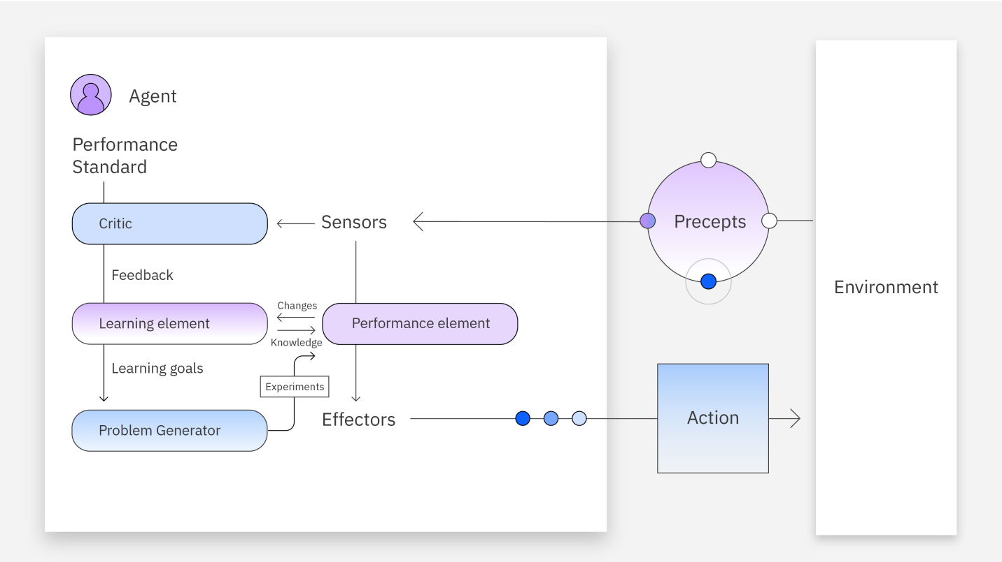
Learning Agents
Adapts and improves over time by updating its behavior based on experiences and feedback, unlike agents that rely only on fixed rules or models.
Highly flexible and capable of handling complex, ever-changing environments.
4 components:
Performance element
Learning element
Critic
Problem generator

Slide 22
Learning Agents
The robot learns user habits and room layouts over time.
Notices that the living room gets dirty in the evening and optimizes cleaning schedules accordingly. Learns the most efficient cleaning paths from past runs.
Continuously adapts to dynamic environments and user preferences.

Slide 23

Quiz

Slide 24
Thank you! Questions?

